Slide 1
Pattern Recognition Class Imbalance Problem
Chumphol Bunkhumpornpat
Department of Computer Science
Faculty of Science
Chiang Mai University

Slide 2
Outline
Imbalance Datasets
Class Imbalance Problem
SMOTE Family
MUTEs

Slide 3
Balance vs Imbalance

Slide 4
Imbalance Dataset

Slide 5
Imbalance Dataset 2

Slide 6
Class Imbalance Problem
-
-
-
Majority
(Negative)
Class
+
Minority
(Positive)
Class
-
-
-
+
-
+
-
-
Under-sampling
Over-sampling
-
-
+
+
-
-
+
+
-
-
+
+

Slide 7
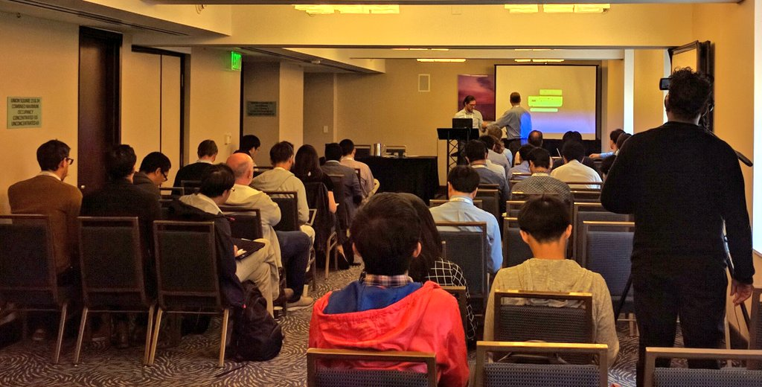
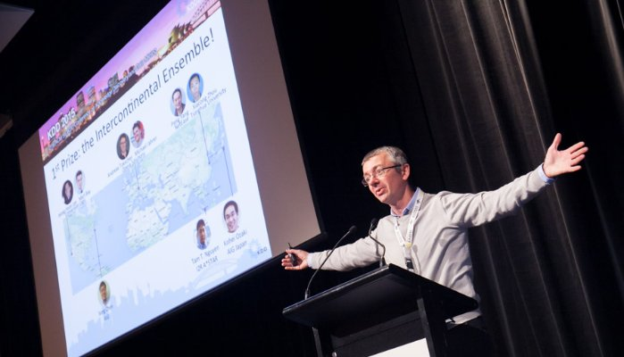
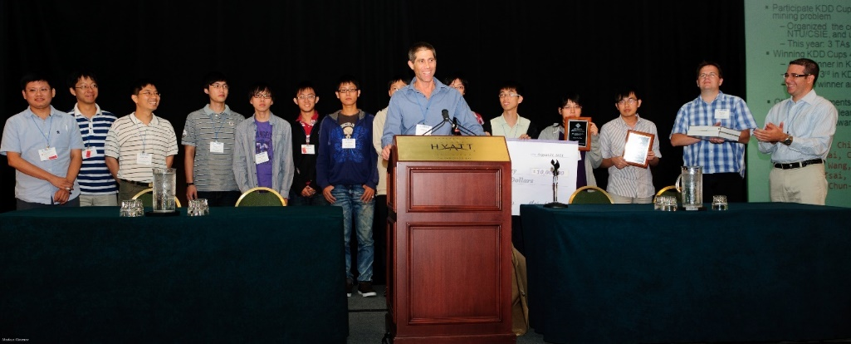

Slide 8
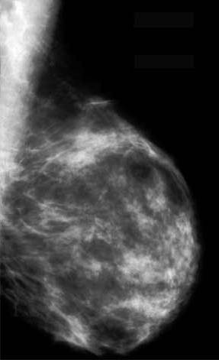
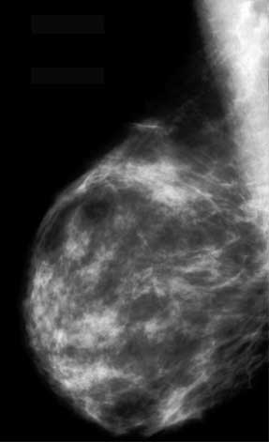
KDD CUP 2008 - Breast Cancer Dataset
MLO CC
MLO CC
MLO ถ่ายแนวเอียง CC ถ่ายด้านตรง
MLO ถ่ายแนวเอียง CC ถ่ายด้านตรง
102,294 Candidates
Malignant
?
[x₁ , x₂ , … , x₁₁₇, class]
Candidate Feature Vector

Slide 9
101,671 Negative (NON-Malignant)
623 Positive (Malignant)
ZeroR: Acc = 99.39%
Notes:
102,294 Candidates
101,671 (99.39%) Region is NOT a malignant mass (negative).
623 (0.61%) Region is a malignant mass (positive).
Accuracy = 99.39%
All negative instances are correctly classified.
All positive instances are incorrectly classified.

Slide 10
Case A
Predict
Case B
Predict
Notes:
Incorrectly Classified Instances
Predicting a cancer candidate as non-cancer: Death
Predicting a non-cancer candidate as cancer: Medical Expense

Slide 11
Performance Measure
Confusion Matrix
 | Predicted Positive | Predicted Negative
Actual Positive | TP: True Positive | FN: False Negative
Actual Negative | FP: False Positive | TN: True Negative
Accuracy = (TP + TN) / (TP + FN + FP + TN)
Recall = TP / (TP + FN)
Precision = TP / (TP + FP)
F-value = ((1 + β²)⋅Recall⋅Precision) / (β²⋅Recall + Precision)

Slide 12
β in F-value
A default β is 1.0, which is the same as the F-measure.
A smaller β, such as 0.5, gives more weight to precision and less to recall in the calculation of the score.
A larger β, such as 2.0, gives less weight to precision and more weight to recall.

Slide 13
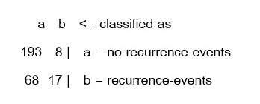

Slide 14
duplicate

Slide 15
SMOTE Algorithm
For the continuous features
Take the difference between a feature vector (minority class sample) and one of its k nearest neighbors (minority class samples).
Multiply this difference by a random number between 0 and 1.
Add this difference to the feature value of the original feature vector, thus creating a new feature vector

Slide 16
SMOTE Algorithm (cont.)
+
+
+
(6, 4)
+
(4, 3)
+
+
+
+
+
+
+
(f1', f2') = (6, 4) + rand(0-1) * (4 - 6, 3 - 4)
(f1', f2') = (6, 4) + rand(0-1) * (-2, -1)

Slide 17
SMOTE Example
(170, 53)
(171, 58)
(175, 60)

Slide 18
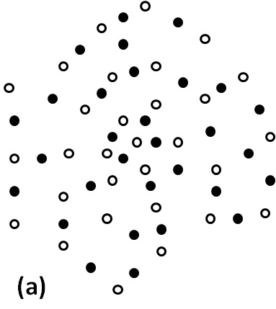
SMOTE N. V. Chawla et al., 2002
Positive Instance
Synthetic Instance

Slide 19
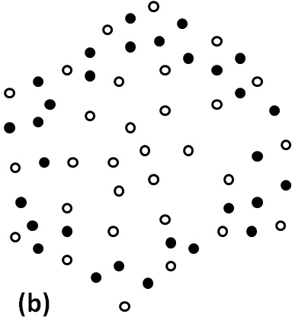
Borderline-SMOTE H. Han et al., 2005
Positive Instance
Synthetic Instance

Slide 20
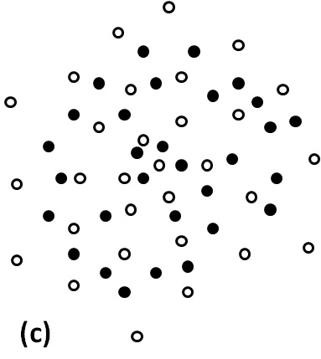
Safe-Level-SMOTE C. Bunkhumpornpat et al., 2009
Positive Instance
Synthetic Instance

Slide 22
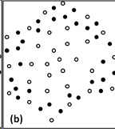
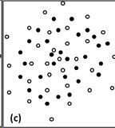
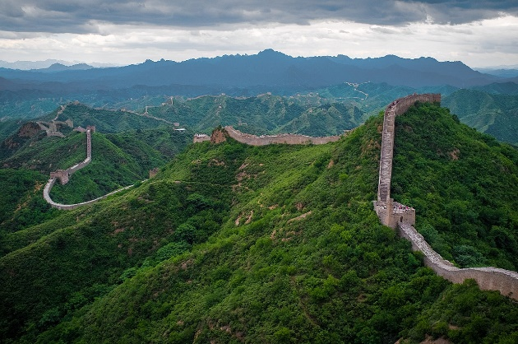
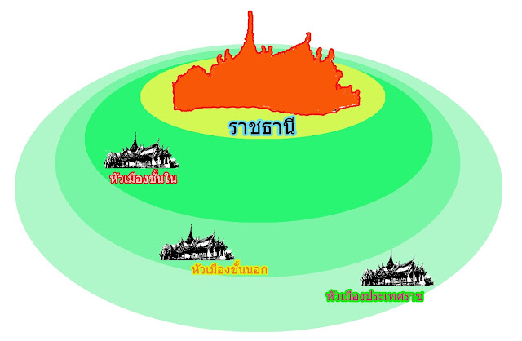
SMOTE
Borderline-SMOTE
Safe-Level-SMOTE

Slide 23
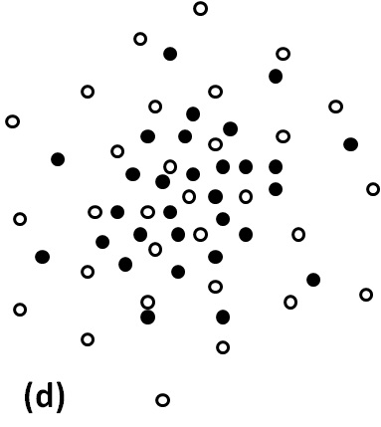
DBSMOTE C. Bunkhumpornpat et al., 2012
Positive Instance
Synthetic Instance

Slide 24
Page-Blocks (Original)
majority class
minority class 2
minority class 4
minority class 5
Notes:
I will illustrate the output of SMOTE family.
This is an original dataset which has 3 minority classes: 2, 4, and 5.

Slide 25
Page-Blocks (SMOTE)
majority class
minority class 2
minority class 4
minority class 5
Notes:
After applying SMOTE to an original dataset, synthetic instances spread throughout a dataset.

Slide 26
Page-Blocks (SAFE)
majority class
minority class 2
minority class 4
minority class 5
Notes:
After applying SAFE, synthetic instances are not dense in the border of a dataset.

Slide 27
Page-Blocks (DBS)
majority class
minority class 2
minority class 4
minority class 5
Notes:
After applying DBS, synthetic instances are dense nearby pseudo-centroid and sparse far from this centroid.

Slide 28
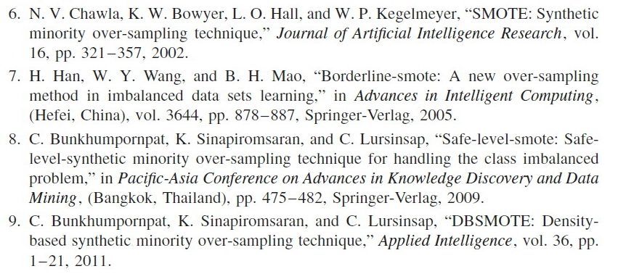

Slide 29
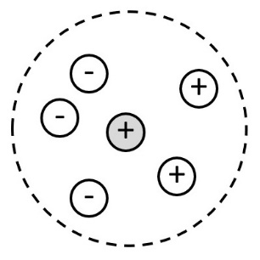
Borderline-SMOTE
½ k ≤ n < k ; n is the number of negative instances

Slide 30
Borderline-SMOTE

Slide 31
Safe-Level-Smote
SL = 2
SL = 4

Slide 32
DBSMOTE
p
Notes:
The algorithm begins to transform a cluster of instances to our graph.
I do not draw the edges in this graph.
Next, determine the pseudo-centroid represented as this black point.
This centroid is assigned by the nearest instance from the mean of a cluster.
Then, run Dijkstra's algorithm.
After that, for each positive instance p, generate a synthetic instance along a shortest path of p to the centroid.
If a cluster has an arbitrary shape similar to this cluster, a synthetic instance will not crash to an opposite-class instance because a shortest path is constructed to be a skeleton path.
Our technique can handle the overlapping problem.

Slide 33
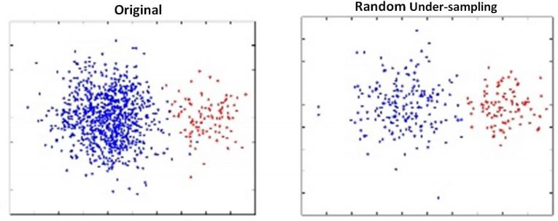
UNDER-SAMPLING
https://analyticsindiamag.com/5-important-techniques-to-process-imbalanced-data-in-machine-learning/

Slide 34
MUTE

Slide 35
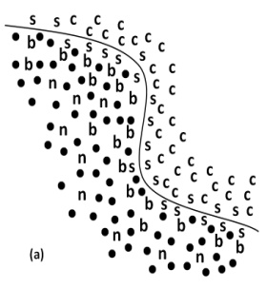
MUTE
n Noise
b Borderline
s Safe
c Core

Slide 36
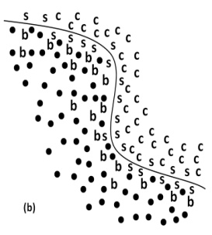
MUTE(D, k)
n Noise
b Borderline
s Safe
c Core

Slide 37
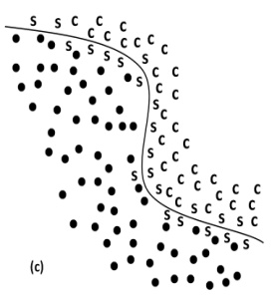
MUTE(D, ½k)
n Noise
b Borderline
s Safe
c Core

Slide 38
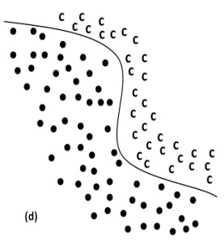
MUTE(D, 1)
n Noise
b Borderline
s Safe
c Core

Slide 39
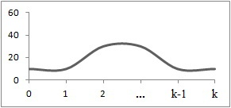
Safe Level Graph: Normal
Safe Level =
The Number of Minority Instances Among the K Nearest Neighbors

Slide 40
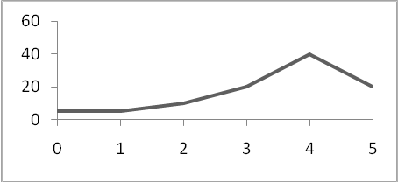
(A) The data has more positive instances in the safe region

Slide 41
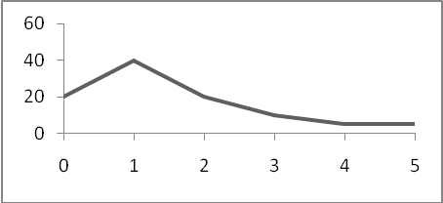
(B) The data has more positive instances in border regions or most positive instances overlap negative instances

Slide 42
References
He, H., Ma, Y.: Imbalanced Learning: Foundations, Algorithms, and Applications. Wiley (2013)
Predictive Modeling in the Wild: Success Factors in Data Mining Competitions and Real-Life Projects. Saharon Rosset, Tel Aviv University and Claudia Perlich, IBM Research

